Slide 1


Chemical and physical properties of DNA: The hyperchromic effect
Lecture 4
Dr. Rawa Abdul Redha Aziz
Ph.D Antibiotics/ Molecular biology

Slide 2
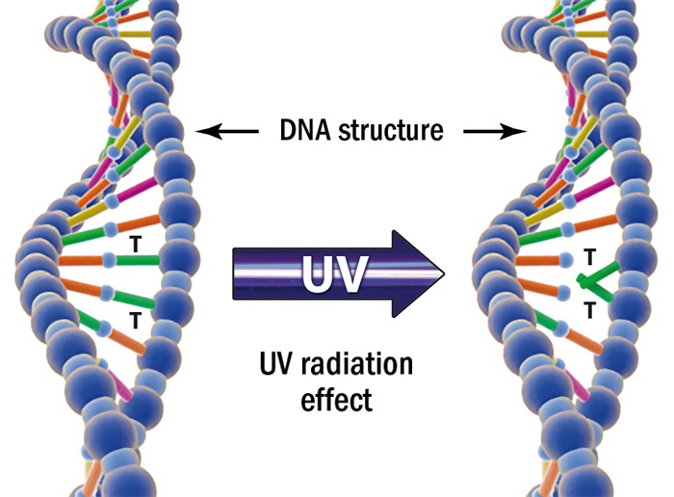
1- Absorption UV Light
The bases in DNA absorb ultraviolet light at the wavelength of 260nm using a spectrophotometer
The less ordered the bases; the more ultraviolet light is absorbed
Free bases absorb 1.60 units at 260nm
Single stranded DNA absorb 1.37 units at 260nm
Double stranded DNA absorb 1.00 units at 260nm

Slide 3
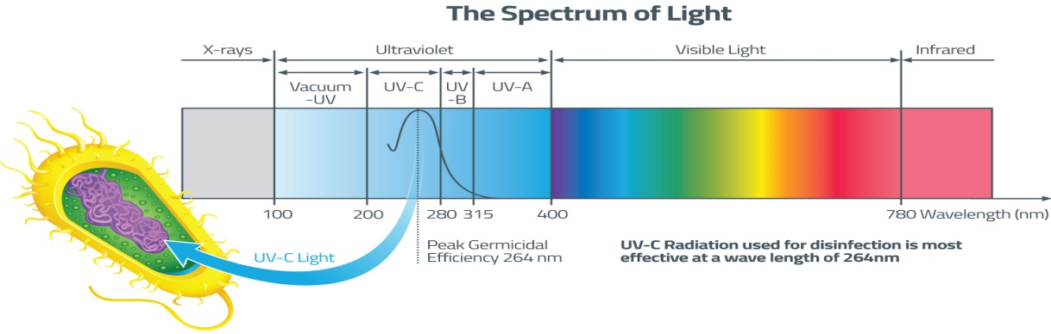
DNA concentration
Since DNA absorbs ultraviolet light at 260nm; thus more DNA presents, the higher the absorbtion.
DNA concentrations can be estimated by comparing its absorption to known concentrations of DNA.
DNA most be fairly pure, since many concentrating substances (e.g, proteins) also absorb around this wavelength (protein absorbed UV at 280nm)

Slide 4
2- Density
Density can be measured by (cesium chloride) CsCl- density ultracentrifugation, will form a density gradient, with the most dense solution at the bottom.
Macromolecules, such as DNA, will concentrate in the area of CsCl that has the same density as themselves hence, more dense DNA will migrate downward and less dense DNA upwards forming bands density can be used to estimate G+C content GC base pairs are more dense than AT base pairs. Therefore, DNA with more GC base pairs will form bands lower down than an equal number of base pairs with high AT contents.

Slide 5
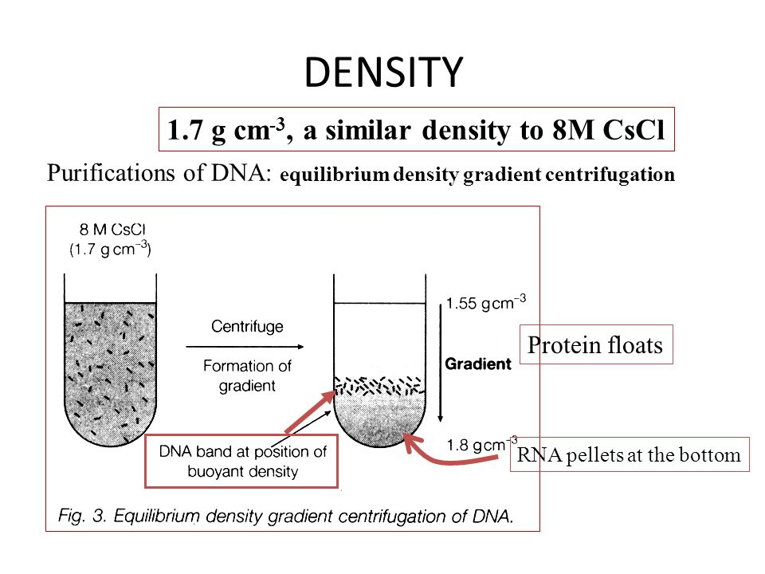

Slide 6
3- Size
A- Electrophoresis
DNA has a negative charge due to the negatively charged phosphate in the sugar-phosphate backbone
If DNA is electrophoresed through a gel, smaller pieces will migrate faster than larger pieces.
Larger pieces have trouble squeezing through the gel matrix and are hence retarded while smaller pieces migrate easier.
Type of gels:
Agarose is used to separate fairly large DNA molecules [ 5 million to a few thousands base pairs]
Polyacrylamide is used to separate small pieces of DNA [2 to several hundred base pairs]
The size of DNA is estimated by comparing its migration through the gel to DNA molecules of known size (DNA ladder).

Slide 7
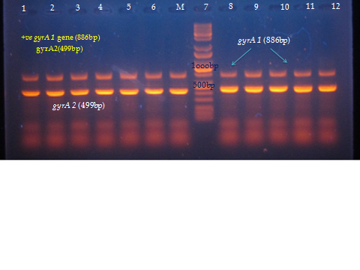

Slide 8
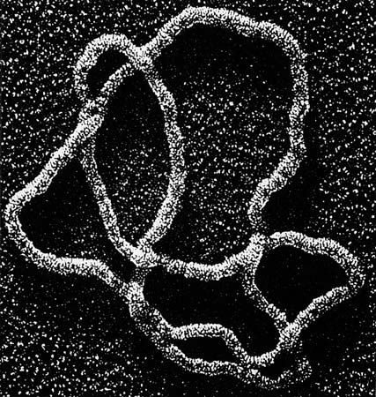
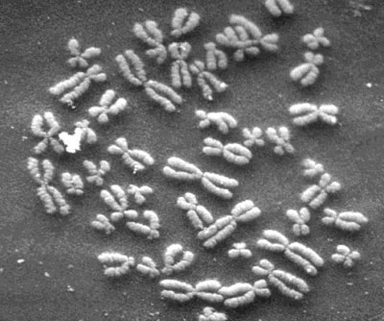
B- Electron microscopy
The size of DNA molecules can be determined by electron microscopy
The DNA is visualized on a grid of known size so that the size of the DNA molecule can be estimated.

Slide 9
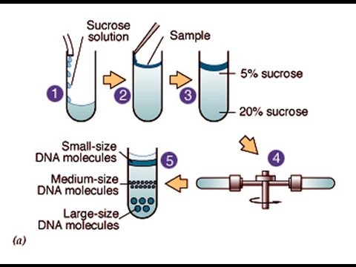
C- Velocity sedimentation
Sedimentation velocity is dependent upon two variables: density and shape
The more dense the DNA, the quicker it will sediment upon centrifugation
Globular (more compact) molecules will sediment faster than liner molecules.

Slide 10
4-Solubility
RNA is more soluble in aqueous solutions then DNA. Ribose has a 2-OH group where deoxyribose contains a 2-H
Hydroxyl groups are polar and dissolve in water better
C-H is a non-polar bond and is therefore hydrophobic
RNA is less stable then DNA
The hydroxyl group on the 2-carbon of ribose is more reactive than the hydrogen found in deoxyribose.

Slide 11
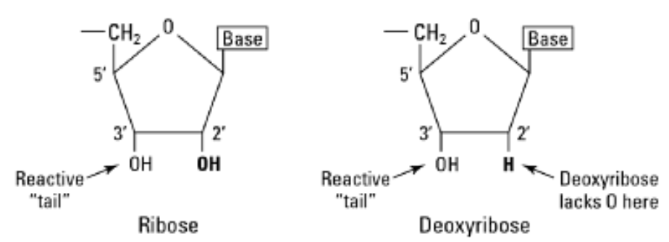

Slide 12
5- Denaturation
DNA is considered denatured when the double stranded DNA molecule is converted into two single stranded DNA molecules.
This can be monitored by noting the increase in absorption of ultraviolet light.
6-Renaturation studies
DNA that has been denatured will often come back together when conditions such as slowly lowering the temperature or adding ions to solution are met. This is referred to as renaturation. The rates of this process are dependent on DNA concentration. It’s important to note that the more molecules of complimentary DNA molecules present, the faster they can find each other and renature and vice versa.

Slide 13
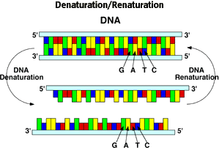

Slide 14
Factors cause DNA Denaturation:
A- Temperature
As thermal energy increases, the frequency of hydrogen bonds breaking between the molecules increases.
As temperature increases, the two molecules will separate into single stranded molecule.
The T_{m} (melting temperature) of a DNA molecule is the temperature in which half the DNA molecules are denatures.
The T_{m} is used to estimate the G+C content of a DNA molecule.
G-C base pairs are held together by three hydrogen bonds (A-Ts by two) and it therefore, takes more energy (higher temperature) to be separated.

Slide 15
*** Hyperchromic effect (Nucleic acid thermodynamics)
It is the study of how temperature affects the nucleic structure of double- stranded DNA (ds DNA). The melting temperature TM is defined as the temperature at which half of the double DNA strands will convert random coil or single-stranded (ssDNA) state. T_{m} depends on the length of the DNA molecule and its specific nucleotide sequence. The ds DNA molecule exists as two independent strands, is referred to as having been denaturated by the high temperature.

Slide 16
B- PH
Acids: pH <1 result in the breakage of phosphodiester bonds between nucleotides and breakage of the N-glycosidic bond between the sugar and purine bases. pH of ~ 4 results in the selective breakage of N-glycosidic bond between the sugar and purine bases. DNA treated this way is referred to a purinic acid, since the purines have been removed.
Alkali: Base tends to change the polarity of a groups involved in hydrogen bonds. Above pH 11.3, all hydrogen bonds are disrupted and the DNA is totally denatured. DNA is resistant to hydrolysis to pH=13. RNA is hydrolyzed into ribonucleotides around pH11.

Slide 17
C-Ionic strength
The phosphates of the DNA sugar-phosphate backbones are negatively charged, so DNA in distilled water will spontaneously denature into single stranded DNA. It is important to say that salts that disassociate into ions will neutralize the charges of the phosphate groups resulting in stabilize the ds DNA leading to higher T_{m} needed.
G+C content
Variation: Higher organisms have a G+C content of about 0.5; while lower organisms range widely from 0.27 to 0.76 for some bacteria.
Estimating G+C content: it can be estimated from its thermal melting temperature (T_{m}).

Slide 18
Hyperdization
Hyperdization is the process of annealing specific interaction between two complementary strands of nucleic acids into a single complex, which in the case of two strands is referred to as a duplex. Oligonucleotides, DNA, or RNA will bind to their complement under normal conditions so two perfectly complementary strands will bind to each other readily. Measuring the effects of base incompatibility by quantifying the temperature at which two strands anneal can provide information as to the similarity in base sequence between the two strands being annealed. The complexes may be dissociated by thermal denaturation, also referred to as melting. Here the solution of complexes is heated to break the hydrogen bonds between nucleic commonly, the pairs of nucleic bases AT and GC are formed, of which the latter is more stable.

Slide 19
Nitrocillulose Filter Hyberdization
Filter hyperdization is a method used to determine the presence of homologous or complementary sequences in DNA or RNA, by allowing a denatured radio-labeled “probe” nucleic acid (in solution) to anneal to the denatured nucleic acid (immobilized to a nitrocellulose filter) to be tested. There are two techniques bellowing to this method: Southern blots and Northern blots.

Slide 20
The southern blot technique is useful for identifying a DNA sequencing that appears only once or twice in the genome.
Procedure: DNA is applied to an agarose gel, and electrophoresis separates the fragments of DNA according to size. The gel is then placed on a thin sponge wick resting in a dish of salt solution, and a special filter (typically nitrocellulose) is placed on top of the gel. A stack of absorbent material (typically paper towels) is placed on the top of this stack. The absorbent material draws the salt solution from the dish into the wick and through the gel by capillary action, which transfers the DNA fragments into the filter. The procedure is called a “Southern transfer” after the filter now contains the DNA fragments in the same pattern as the gel.

Slide 21
The filter is placed in a standard solution of radioactivity- labeled DNA probe for a particular gene sequence. The probe binds to the filter only where a complementary DNA sequence is located. After washing to remove unbound probe, a piece of X-ray film is placed over the hybridized filter and left for several hours to several days. The radioactive label produces a black band on the film where it has stuck to the complementary DNA, producing an autoradiogram. If a labeled size marker has been used, the exact size of the fragments can be determined.

Slide 22
The steps of southern and northern blotting are the same only when DNA sample is replaced with RNA in the second procedure.

Slide 23
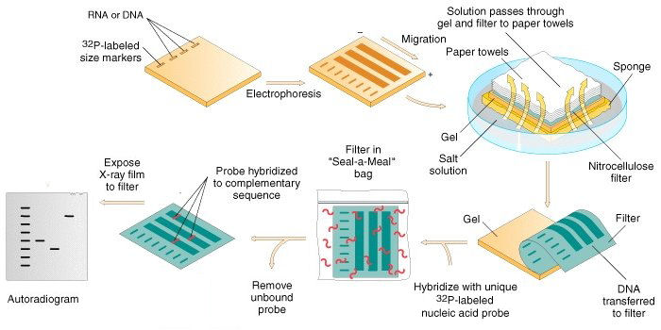

Slide 24
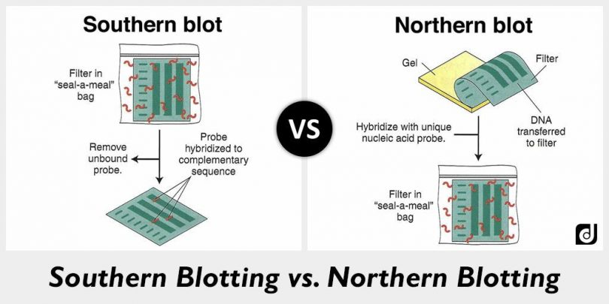

Slide 25


